Slide 1



Gestão de Frotas
View in Power BI
Last data refresh:
15/10/2022 23:49:08 UTC
Downloaded at:
15/10/2022 23:53:58 UTC

Slide 2

Home
Notes:
actionButton
No alt text provided

Slide 3
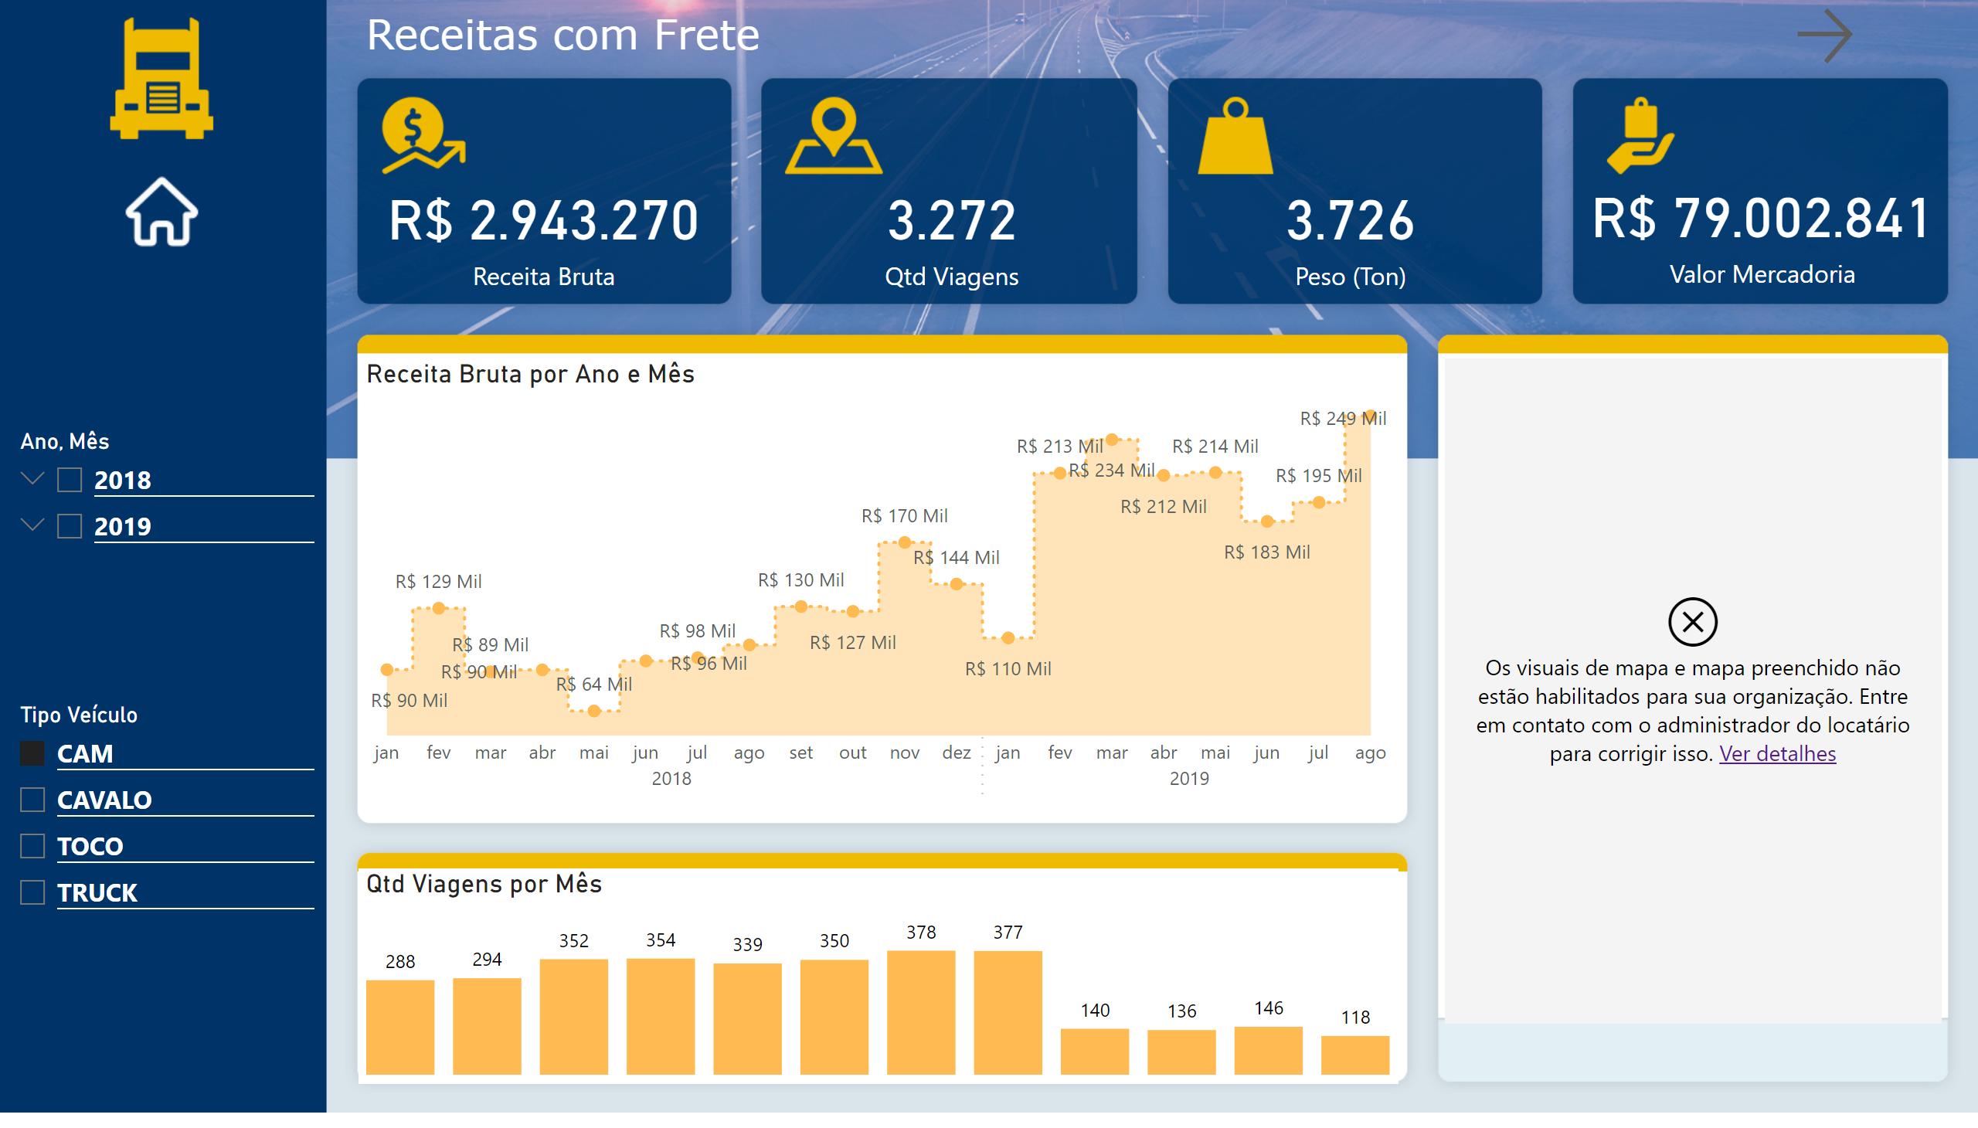
Receitas com Frete
Notes:
card
No alt text provided
card
No alt text provided
card
No alt text provided
card
No alt text provided
areaChart
No alt text provided
slicer
No alt text provided
slicer
No alt text provided
clusteredColumnChart
No alt text provided
map
No alt text provided
textbox
No alt text provided
actionButton
No alt text provided
image
No alt text provided
actionButton
No alt text provided

Slide 4
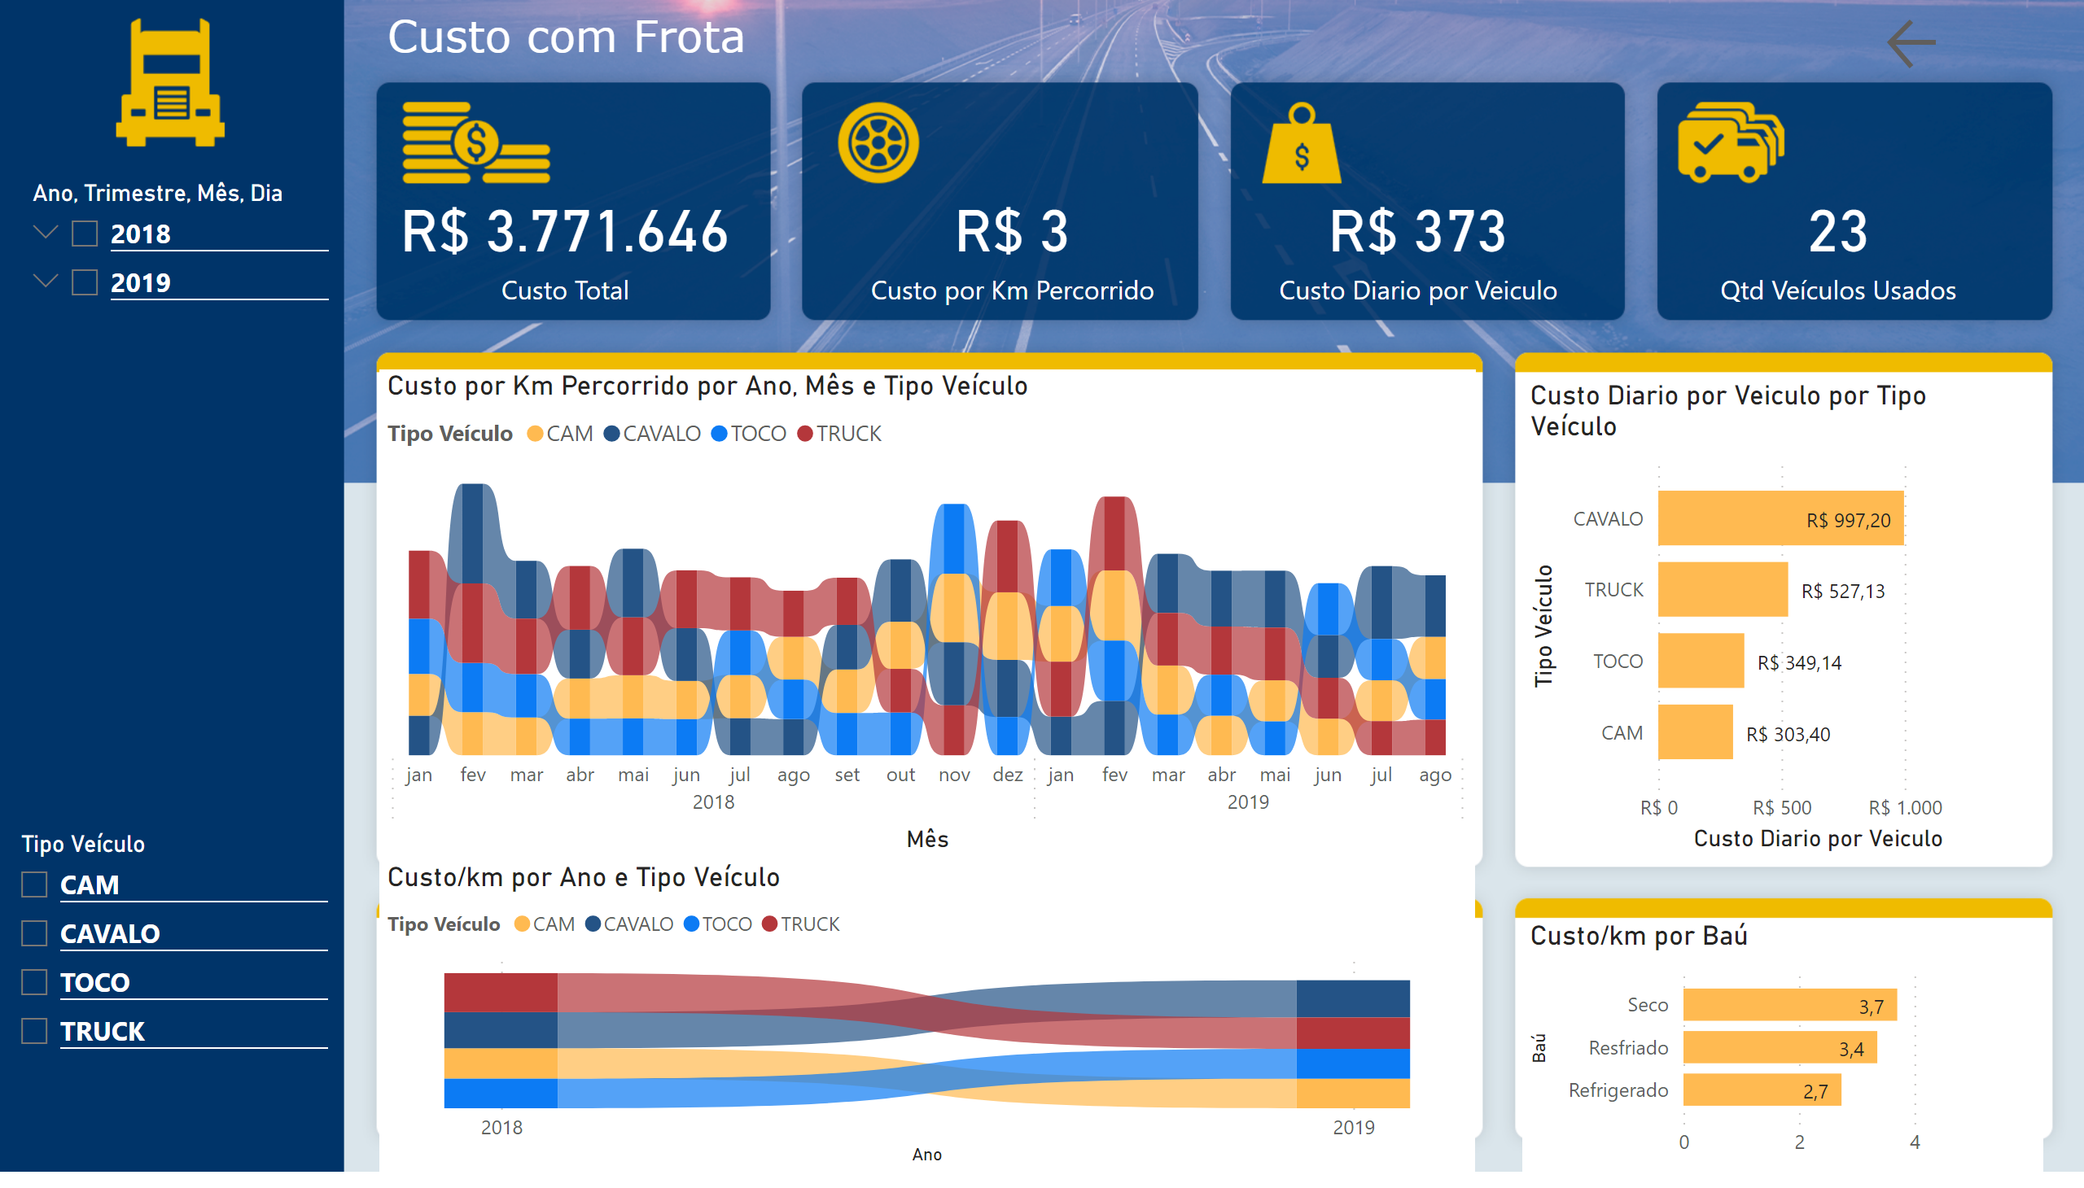
Custo com Frota
Notes:
card
No alt text provided
card
No alt text provided
card
No alt text provided
card
No alt text provided
ribbonChart
No alt text provided
slicer
No alt text provided
slicer
No alt text provided
clusteredBarChart
No alt text provided
clusteredBarChart
No alt text provided
ribbonChart
No alt text provided
textbox
No alt text provided
actionButton
No alt text provided

